Slide 1
Mini project ii COLOUR EXTRACTION AND IMAGE HISTOGRAM
PROJECT TEAM MEMBERS –
DIXIT VEDANT
HINGRAJIYA SHYAM
NAGARE ANURAG
SHINDE ANIKET

Slide 2
ABOUT PROJECT
PROJECT IS TITLED AS IMAGE PROCESSING / COLOUR RECOGNITION.
CONTAINS TWO MODULES :
COLOUR EXTRACTION
IMAGE HISTOGRAM GENERATION
PROJECT WILL BE DEVELOPED USING PYTHON PROGRAMMING LANGUAGE WITH GUI FRAMEWORKS AND OTHER PYTHON LIBRARIES SUCH AS OPENCV CV2, NUMPY , PILLOW & TKINTER.

Slide 3
SYSTEM SPECS
OPERATING SYSTEM: WINDOWS 8, 10 or LINUX
HDD: 500GB+
RAM: MIN 4GB
PROCESSOR: MIN i5 2.8GHz+
IMAGE CAPTURE DEVICE (WEBCAM)
PYTHON IDLE 3.10
PIP LIBRARY
OPEN CV CV2 LIBRARY
TKINTER LIBRARY

Slide 4
PROJECT PROCESS
INPUT: IMAGE IN .PNG, .JPG or .JPEG FORMAT OR DYNAMIC WEB-CAM CAPTURE.
EXPECTED PRIMARY OUTPUT: IMAGE’S RGB RANGE AND COLOR PALETTE
SECONDARY OUTPUT: LOCAL IMAGE’S DENSITY BASED HISTOGRAM CHART FOR DATA ANALYSIS

Slide 5
SOFTWARE MODULE – COLOUR EXTRACTOR
USER INTERFACE
WEB-CAM
CAPTURE
PROCESSING
RGB PALETTE

Slide 6
SOFTWARE MODULE – IMAGE HISTOGRAM
USER INTERFACE
LOCAL
IMAGE
PROCESSING
IMAGE
HISTOGRAM

Slide 7
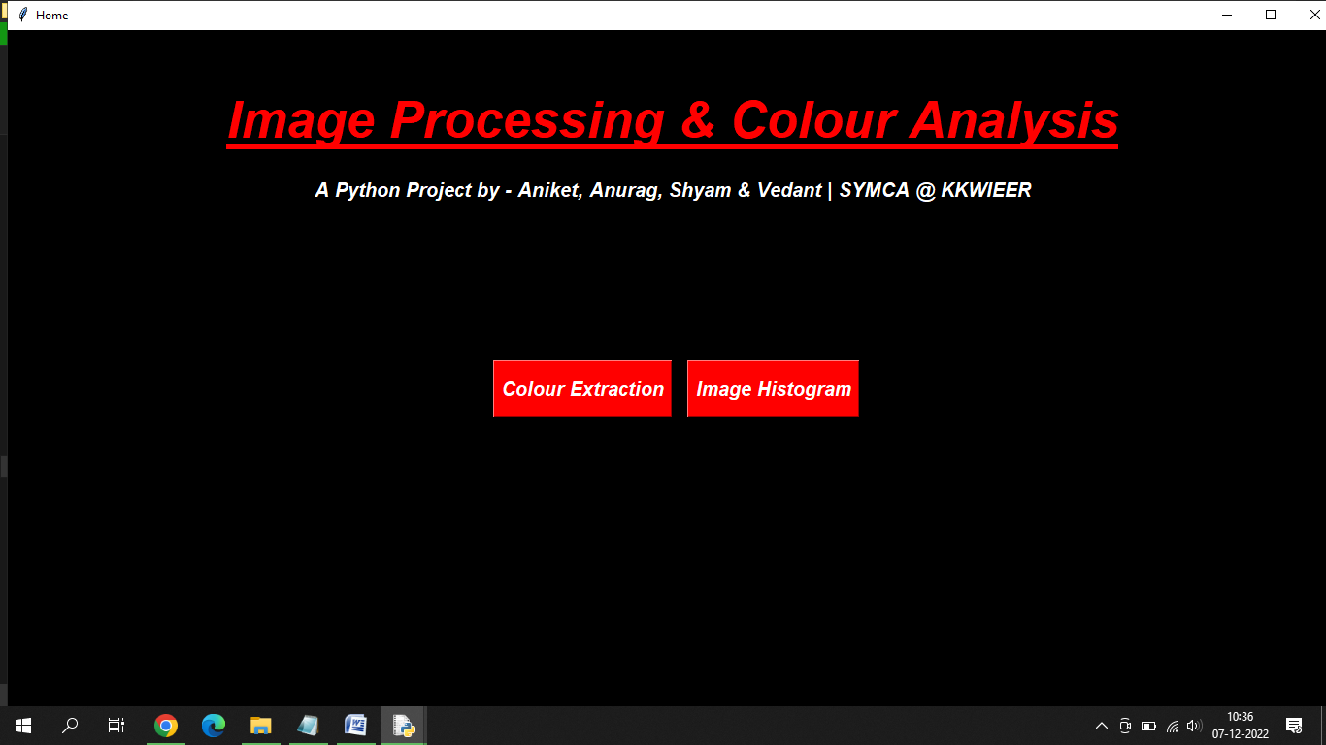
HOMESCREEN

Slide 8
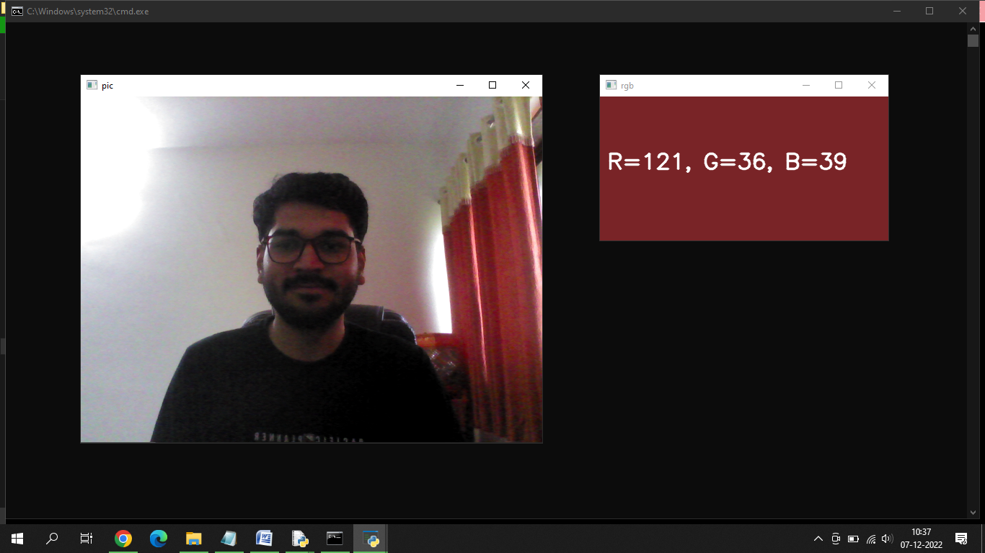
COLOUR EXTRACTOR (DYNAMIC CAPTURE)

Slide 9
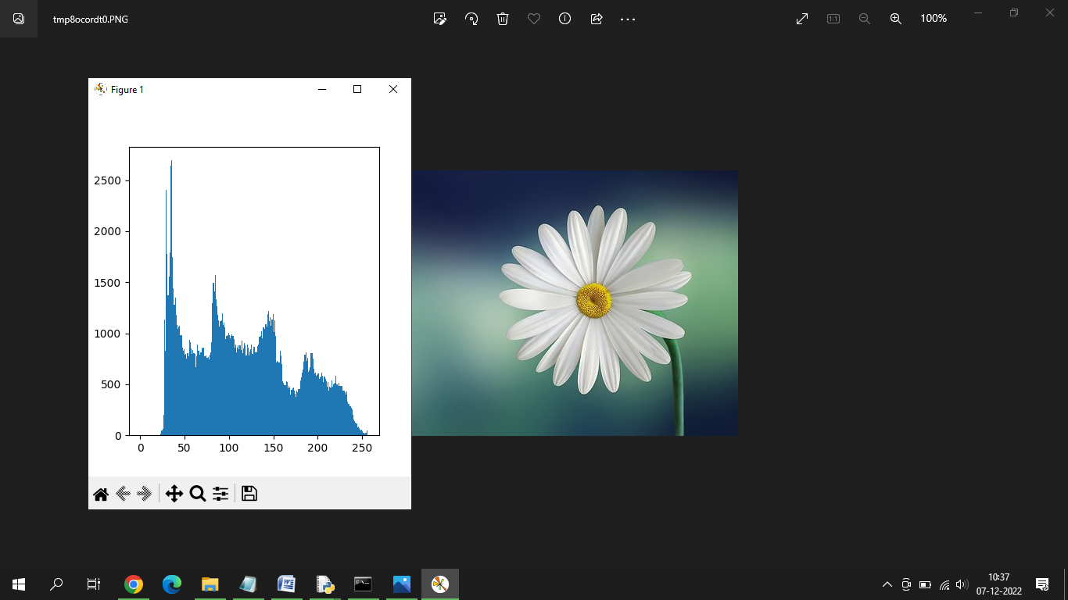
IMAGE HISTOGRAM (STATIC PROCESS)

Slide 10
THANK YOU
Presented by :
VEDANT DIXIT
On behalf of team members :
HINGRAJIYA SHYAM
NAGARE ANURAG
SHINDE ANIKET

